Slide 1
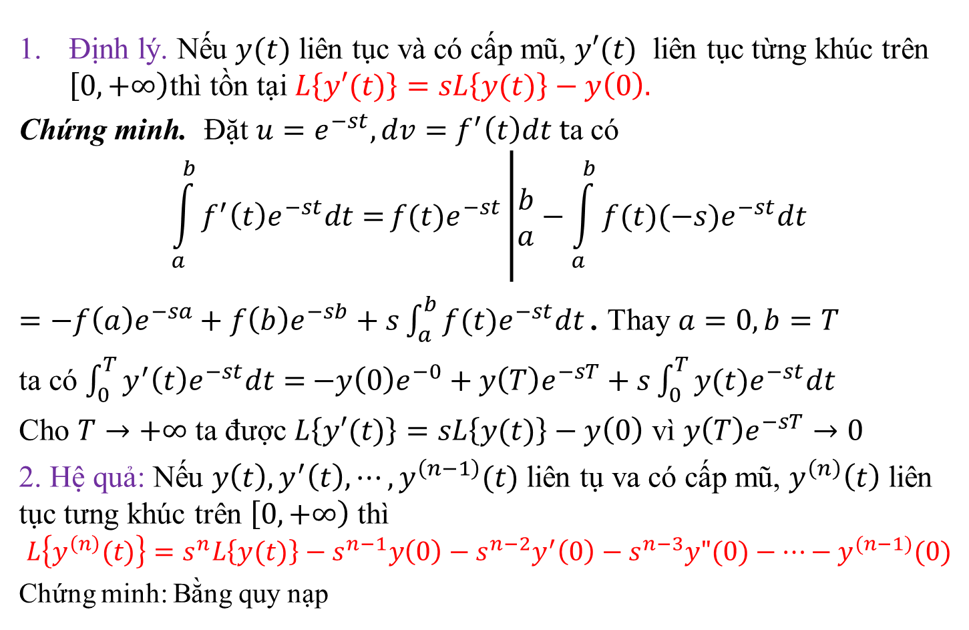
$2. Phép biến đổi Laplace với bài toán Cauchy
Định lý. Nếu $y(t)$ liên tục và có cấp mũ, $y′(t)$ liên tục từng khúc trên $\left[0,\left.+∞\right)\right.$thì tồn tại $L\left\{y′(t)\right\}=sL\left\{y(t)\right\}−y\left(0\right).$
Chứng minh. Đặt $u=e^{−st}, dv=f^{′}\left(t\right)dt t$a có
$$\int_{a}^{b}{f^{′}\left(t\right)e^{−st}dt=}f(t)e^{−st}\left|\begin{matrix}b \\ a\end{matrix}−\int_{a}^{b}{f(t)(−s)e^{−st}dt}\right.$$
$=−f\left(a\right)e^{−sa}+f\left(b\right)e^{−sb}+s\int_{a}^{b}{f(t)e^{−st}dt}$ . Thay $a=0,b=T$
ta có $\int_{0}^{T}{y^{′}\left(t\right)e^{−st}dt=}$ $−y\left(0\right)e^{−0}+y\left(T\right)e^{−sT}+s\int_{0}^{T}{y(t)e^{−st}dt}$
Cho $T→+∞$ ta được $L\left\{y′(t)\right\}=sL\left\{y(t)\right\}−y\left(0\right)$ vì $y\left(T\right)e^{−sT}→0$
2. Hệ quả: Nếu $y\left(t\right),y^{′}\left(t\right),⋯,y^{\left(n−1\right)}(t)$ liên tụ va có cấp mũ, $y^{\left(n\right)}\left(t\right)$ liên tục tưng khúc trên $\left[0, \left.+∞\right) \right.$thì
$$L\left\{y^{\left(n\right)}(t)\right\}=s^{n}L\left\{y(t)\right\}−s^{n−1}y\left(0\right)−s^{n−2}y^{′}\left(0\right)−s^{n−3}y"(0)−⋯−y^{(n−1)}(0)$$
Chứng minh: Bằng quy nạp

Slide 2
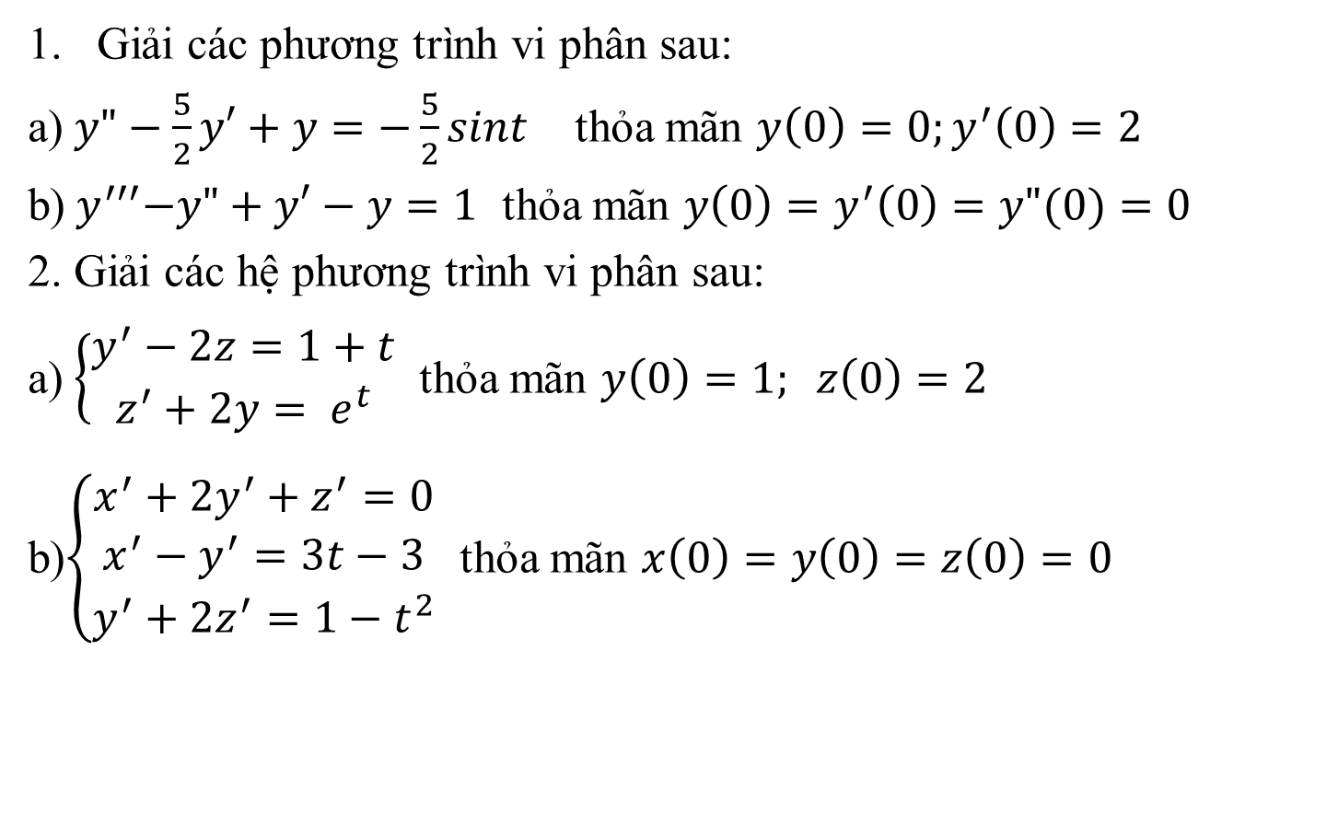
3. Các ví dụ giải PTVP và Hệ PTVP
Giải các phương trình vi phân sau:
a) $y"−\frac{5}{2}y′+y=−\frac{5}{2}sint$ thỏa mãn $y\left(0\right)=0;y^{′}\left(0\right)=2$
b)${ y}^{′′′}−y"+y′−y=1$ thỏa mãn $y\left(0\right)=y^{′}\left(0\right)=y"(0)=0$
2. Giải các hệ phương trình vi phân sau:
a) $\left\{\begin{matrix}y^{′}−2z=1+t \\ z^{′}+2y= e^{t}\end{matrix}\right.$ thỏa mãn $y\left(0\right)=1; z\left(0\right)=2$
b)$\left\{\begin{matrix}x^{′}+2y^{′}+z^{′}=0 \\ x^{′}−y^{′}=3t−3 \\ y^{′}+{2z}^{′}=1−t^{2}\end{matrix}\right.$ thỏa mãn $x\left(0\right)=y\left(0\right)=z\left(0\right)=0$

Slide 3
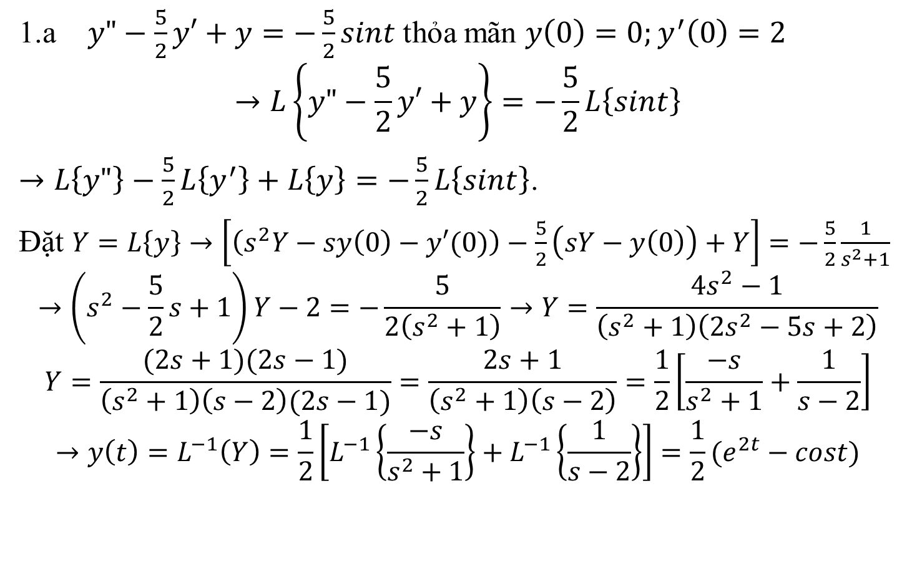
Giải:
1.a $y"−\frac{5}{2}y′+y=−\frac{5}{2}sint$ thỏa mãn $y\left(0\right)=0;y^{′}\left(0\right)=2$
$$→L\left\{y"−\frac{5}{2}y′+y\right\}=−\frac{5}{2}L\left\{sint\right\}$$
$→L\left\{y"\right\}−\frac{5}{2}L\left\{y^{′}\right\}+L\left\{y\right\}=−\frac{5}{2}L\left\{sint\right\}$.
Đặt $Y=L\left\{y\right\}→\left[\left(s^{2}Y−sy\left(0\right)−y′(0)\right)−\frac{5}{2}\left(sY−y\left(0\right)\right)+Y\right]=−\frac{5}{2}\frac{1}{s^{2}+1}$
$$→\left(s^{2}−\frac{5}{2}s+1\right)Y−2=−\frac{5}{2\left(s^{2}+1\right)}→Y=\frac{4s^{2}−1}{\left(s^{2}+1\right)\left(2s^{2}−5s+2\right)}$$
$$Y=\frac{(2s+1)(2s−1)}{\left(s^{2}+1\right)\left(s−2\right)(2s−1)}=\frac{2s+1}{\left(s^{2}+1\right)\left(s−2\right)}=\frac{1}{2}\left[\frac{−s}{s^{2}+1}+\frac{1}{s−2}\right]$$
$$→y\left(t\right)=L^{−1}\left(Y\right)=\frac{1}{2}\left[L^{−1}\left\{\frac{−s}{s^{2}+1}\right\}+L^{−1}\left\{\frac{1}{s−2}\right\}\right]=\frac{1}{2}(e^{2t}−cost)$$

Slide 4
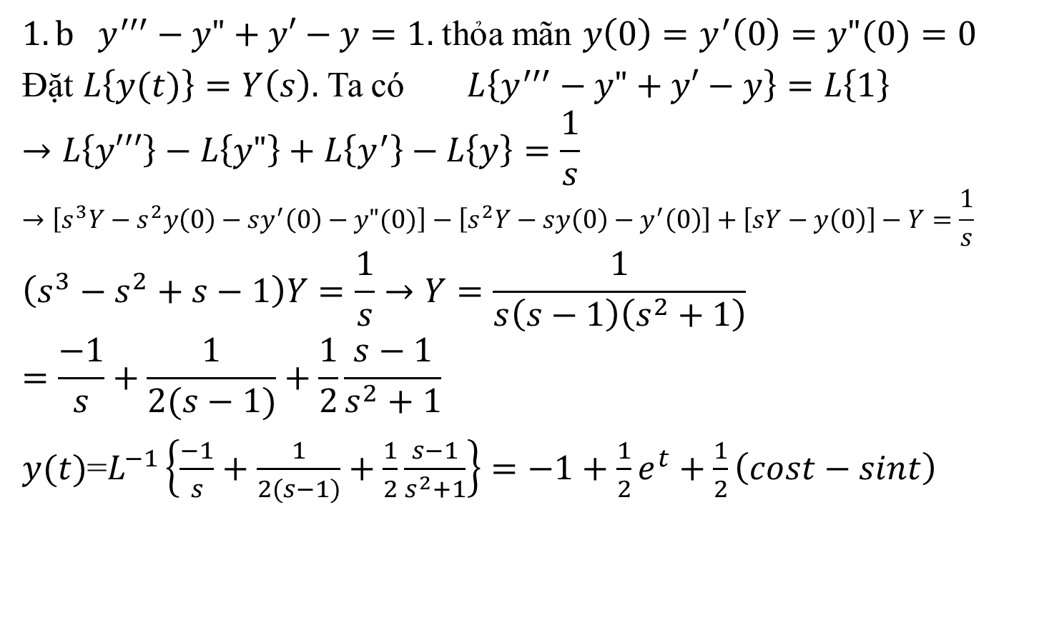
Giải:
${1.b y}^{′′′}−y"+y′−y=1.$thỏa mãn $y\left(0\right)=y^{′}\left(0\right)=y"(0)=0$
Đặt $L\left\{y(t)\right\}=Y\left(s\right).$ Ta có $L\left\{y^{′′′}−y"+y′−y\right\}=L\left\{1\right\}$
$$→L\left\{y′′′\right\}−L\left\{y"\right\}+L\left\{y^{′}\right\}−L\left\{y\right\}=\frac{1}{s}$$
$$→\left[s^{3}Y−s^{2}y\left(0\right)−sy^{′}\left(0\right)−y"(0)\right]−\left[s^{2}Y−sy\left(0\right)−y^{′}\left(0\right)\right]+\left[sY−y\left(0\right)\right]−Y=\frac{1}{s}$$
$$\left(s^{3}−s^{2}+s−1\right)Y=\frac{1}{s}→Y=\frac{1}{s\left(s−1\right)\left(s^{2}+1\right)}=\frac{−1}{s}+\frac{1}{2(s−1)}+\frac{1}{2}\frac{s−1}{s^{2}+1}$$
$y(t)$=$L^{−1}\left\{\frac{−1}{s}+\frac{1}{2(s−1)}+\frac{1}{2}\frac{s−1}{s^{2}+1}\right\}=−1+\frac{1}{2}e^{t}+\frac{1}{2}\left(cost−sint\right)$

Slide 5
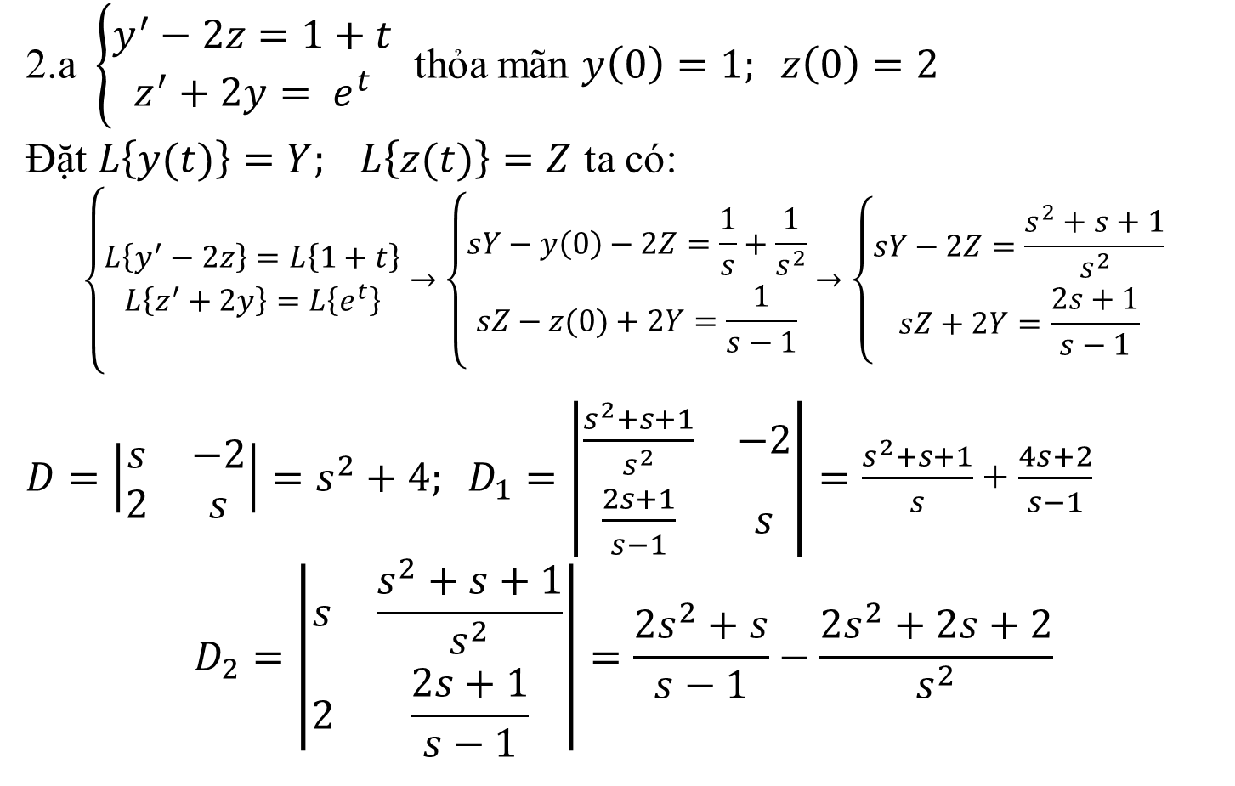
Giải.
2.a $\left\{\begin{matrix}y^{′}−2z=1+t \\ z^{′}+2y= e^{t}\end{matrix}\right.$ thỏa mãn $y\left(0\right)=1; z\left(0\right)=2$
Đặt $L\left\{y(t)\right\}=Y; L\left\{z(t)\right\}=Z$ ta có:
$$\left\{\begin{matrix}L\left\{y^{′}−2z\right\}=L\left\{1+t\right\} \\ L\left\{z^{′}+2y\right\}=L\left\{e^{t}\right\}\end{matrix}→\left\{\begin{matrix}sY−y\left(0\right)−2Z=\frac{1}{s}+\frac{1}{s^{2}} \\ sZ−z(0)+2Y=\frac{1}{s−1}\end{matrix}→\left\{\begin{matrix}sY−2Z=\frac{s^{2}+s+1}{s^{2}} \\ sZ+2Y=\frac{2s+1}{s−1}\end{matrix}\right.\right.\right.$$
$D=\left|\begin{matrix}s & −2 \\ 2 & s\end{matrix}\right|=s^{2}+4; D_{1}=\left|\begin{matrix}\frac{s^{2}+s+1}{s^{2}} & −2 \\ \frac{2s+1}{s−1} & s\end{matrix}\right|=\frac{s^{2}+s+1}{s}$ + $\frac{4s+2}{s−1}$
$$D_{2}=\left|\begin{matrix}s & \frac{s^{2}+s+1}{s^{2}} \\ 2 & \frac{2s+1}{s−1}\end{matrix}\right|=\frac{2s^{2}+s}{s−1}−\frac{2s^{2}+2s+2}{s^{2}}$$

Slide 6
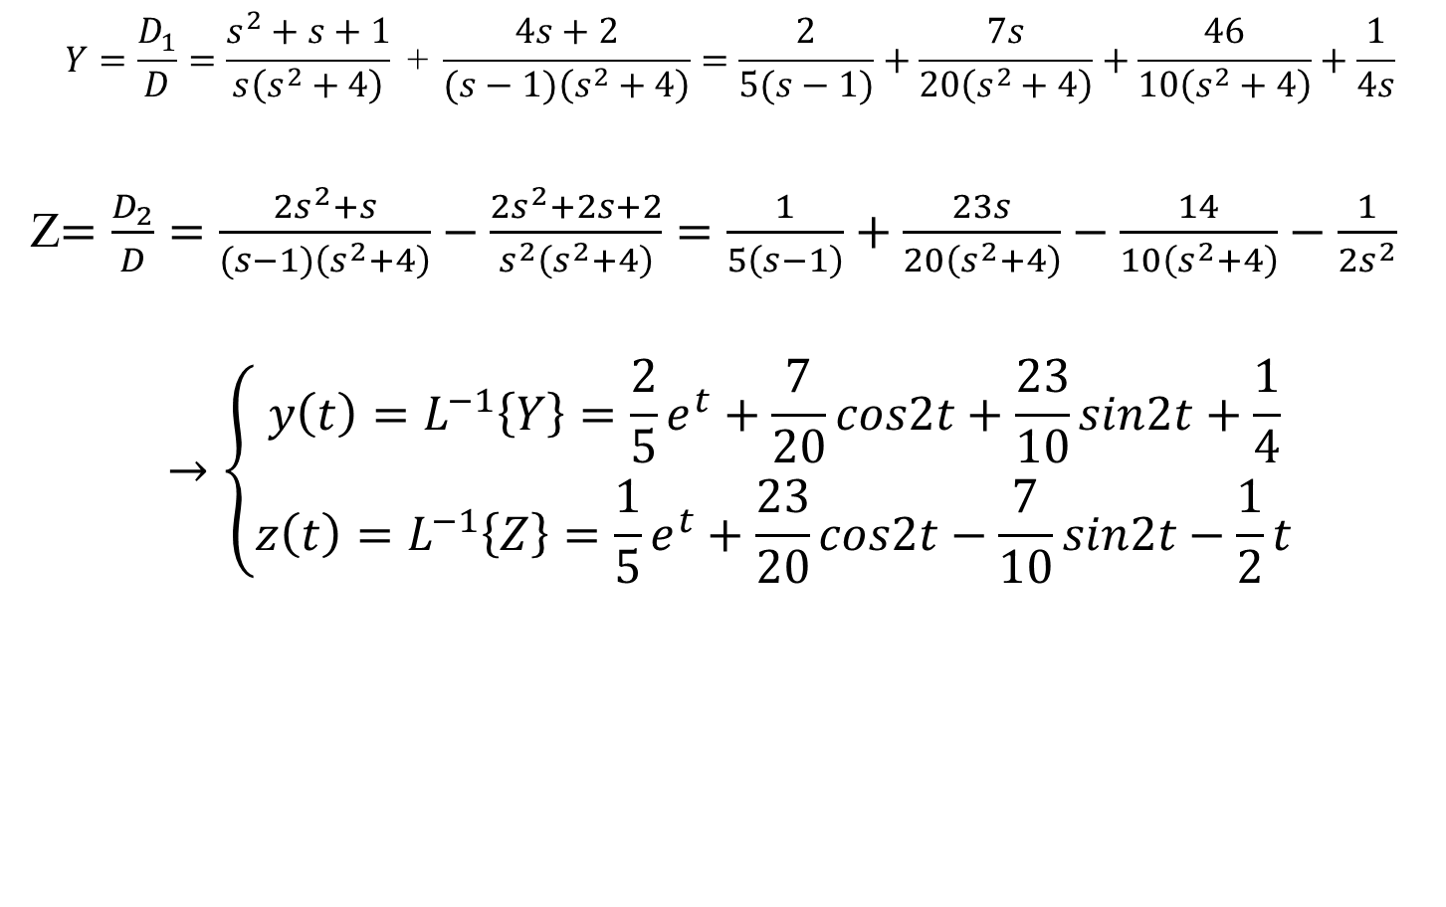
2.a (tiếp)
$$Y=\frac{D_{1}}{D}=\frac{s^{2}+s+1}{s\left(s^{2}+4\right)}\text{ + }\frac{4s+2}{(s−1)\left(s^{2}+4\right)}=\frac{2}{5(s−1)}+\frac{7s}{20\left(s^{2}+4\right)}+\frac{46}{10\left(s^{2}+4\right)}+\frac{1}{4s}$$
Z$=\frac{D_{2}}{D}=\frac{2s^{2}+s}{(s−1)\left(s^{2}+4\right)}−\frac{2s^{2}+2s+2}{s^{2}\left(s^{2}+4\right)}=\frac{1}{5\left(s−1\right)}+\frac{23s}{20\left(s^{2}+4\right)}−\frac{14}{10\left(s^{2}+4\right)}−\frac{1}{2s^{2}}$
$$→\left\{\begin{matrix}y\left(t\right)=L^{−1}\left\{Y\right\}=\frac{2}{5}e^{t}+\frac{7}{20}cos2t+\frac{23}{10}sin2t+\frac{1}{4} \\ z\left(t\right)=L^{−1}\left\{Z\right\}=\frac{1}{5}e^{t}+\frac{23}{20}cos2t−\frac{7}{10}sin2t−\frac{1}{2}t\end{matrix}\right.$$

Slide 7
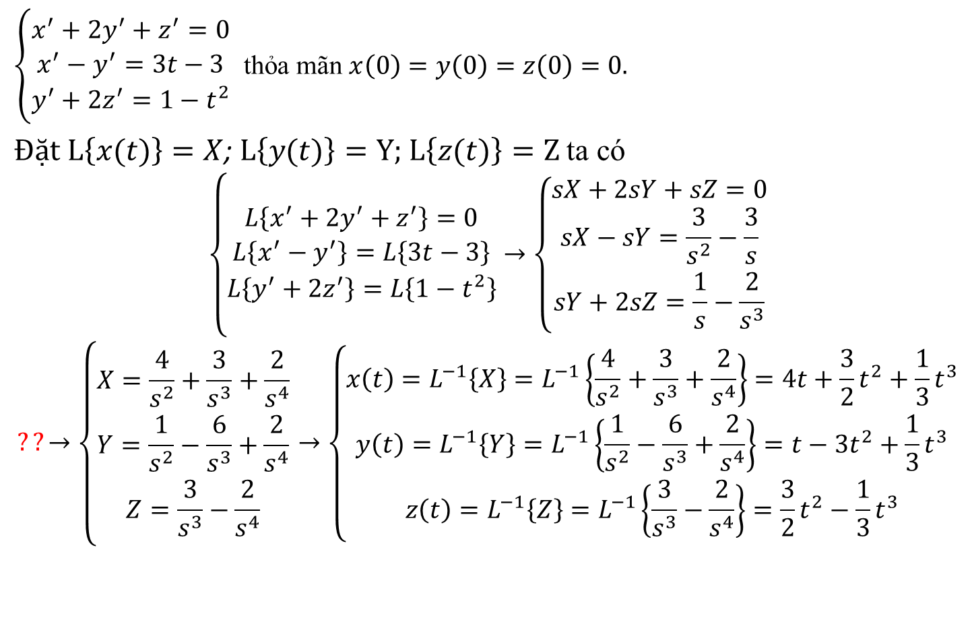
2.b
$\left\{\begin{matrix}x^{′}+2y^{′}+z^{′}=0 \\ x^{′}−y^{′}=3t−3 \\ y^{′}+{2z}^{′}=1−t^{2}\end{matrix}\right.$ thỏa mãn $x\left(0\right)=y\left(0\right)=z\left(0\right)=0.$
$Đặt L\left\{x(t)\right\}=X$; $L\left\{y(t)\right\}=Y;$ $L\left\{z(t)\right\}=Z$ ta có
$$\left\{\begin{matrix}L\left\{x^{′}+2y^{′}+z^{′}\right\}=0 \\ L\left\{x^{′}−y^{′}\right\}=L\left\{3t−3\right\} \\ L\left\{y^{′}+{2z}^{′}\right\}=L\left\{1−t^{2}\right\}\end{matrix}→\left\{\begin{matrix}sX+2sY+sZ=0 \\ sX−sY=\frac{3}{s^{2}}−\frac{3}{s} \\ sY+2sZ=\frac{1}{s}−\frac{2}{s^{3}}\end{matrix}\right.\right.$$
$$??→\left\{\begin{matrix}X=\frac{4}{s^{2}}+\frac{3}{s^{3}}+\frac{2}{s^{4}} \\ Y=\frac{1}{s^{2}}−\frac{6}{s^{3}}+\frac{2}{s^{4}} \\ Z=\frac{3}{s^{3}}−\frac{2}{s^{4}}\end{matrix}→\left\{\begin{matrix}x\left(t\right)=L^{−1}\left\{X\right\}=L^{−1}\left\{\frac{4}{s^{2}}+\frac{3}{s^{3}}+\frac{2}{s^{4}}\right\}=4t+\frac{3}{2}t^{2}+\frac{1}{3}t^{3} \\ y\left(t\right)=L^{−1}\left\{Y\right\}=L^{−1}\left\{\frac{1}{s^{2}}−\frac{6}{s^{3}}+\frac{2}{s^{4}}\right\}=t−3t^{2}+\frac{1}{3}t^{3} \\ z\left(t\right)=L^{−1}\left\{Z\right\}=L^{−1}\left\{\frac{3}{s^{3}}−\frac{2}{s^{4}}\right\}=\frac{3}{2}t^{2}−\frac{1}{3}t^{3}\end{matrix}\right.\right.$$

Slide 8
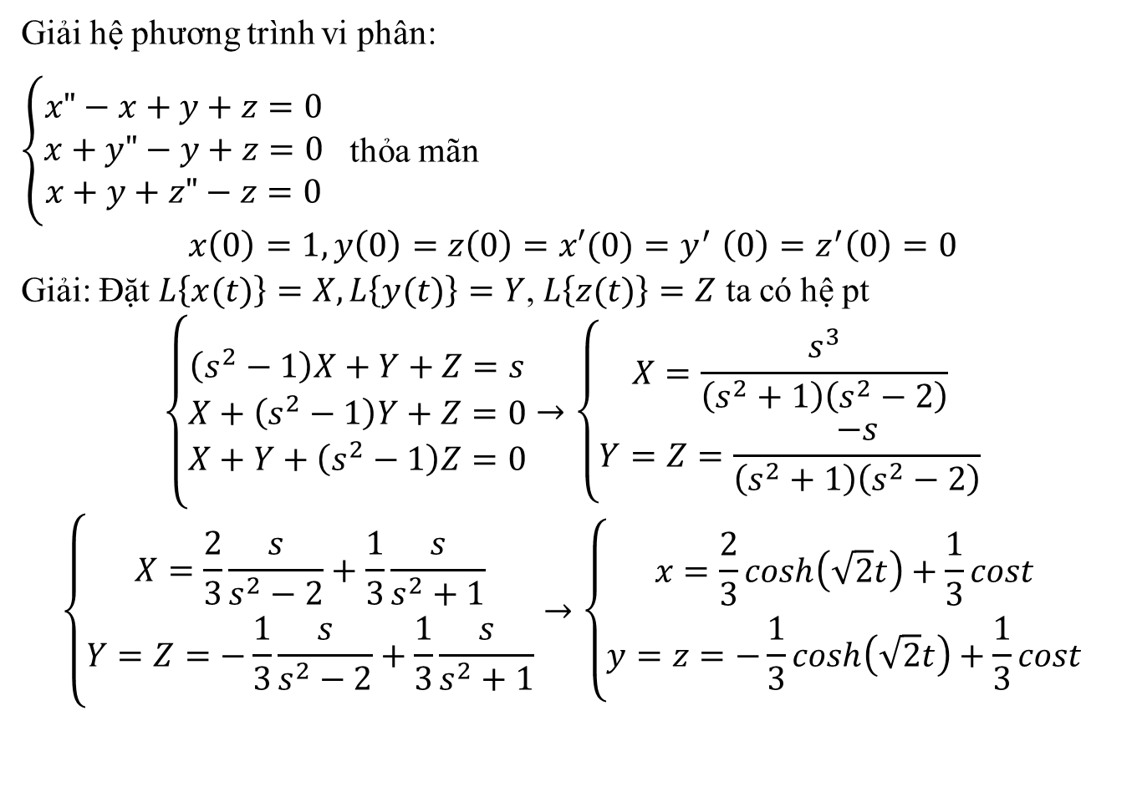
Ví dụ hệ PTVP tuyến tính cấp 2
Giải hệ phương trình vi phân:
$\left\{\begin{matrix}x"−x+y+z=0 \\ x+y"−y+z=0 \\ x+y+z"−z=0\end{matrix}\right.$ thỏa mãn
$$x\left(0\right)=1, y\left(0\right)=z\left(0\right){=x′(0)=y}^{′}\left(0\right)=z^{′}\left(0\right)=0$$
Giải: Đặt $L\left\{x(t)\right\}=X,L\left\{y(t)\right\}=Y$, $L\left\{z(t)\right\}=Z$ ta có hệ pt
$$\left\{\begin{matrix}\left(s^{2}−1\right)X+Y+Z=s \\ X+\left(s^{2}−1\right)Y+Z=0 \\ X+Y+\left(s^{2}−1\right)Z=0\end{matrix}→\left\{\begin{matrix}X=\frac{s^{3}}{\left(s^{2}+1\right)\left(s^{2}−2\right)} \\ Y=Z=\frac{−s}{\left(s^{2}+1\right)\left(s^{2}−2\right)}\end{matrix}\right.\right.$$
$$\left\{\begin{matrix}X=\frac{2}{3}\frac{s}{s^{2}−2}+\frac{1}{3}\frac{s}{s^{2}+1} \\ Y=Z=−\frac{1}{3}\frac{s}{s^{2}−2}+\frac{1}{3}\frac{s}{s^{2}+1}\end{matrix}→\left\{\begin{matrix}x=\frac{2}{3}cosh\left(\sqrt{2}t\right)+\frac{1}{3}cost \\ y=z=−\frac{1}{3}cosh\left(\sqrt{2}t\right)+\frac{1}{3}cost\end{matrix}\right.\right.$$

